Slide 1

IoT BASED SMART HOME USING ESP32 DEVELOPMENT KIT
UNIVERSITY OF NORTH TEXAS
DEPARTMENT OF COMPUTER SCIENCE AND ENGINEERING
By
NAME:SRINU PERUMALLA
ID:11750704
Department of Computer Science & Engg
University Of North Texas
Instructor:
Prof.Dr.Saraju P Mohanty
Department of Computer Science & Engg
University Of North Texas

Slide 2

Contents
Abstract
Introduction
Existing models
Proposed Model
Components
Software Requirements
Results
Conclusion and Future scope
References

Slide 3
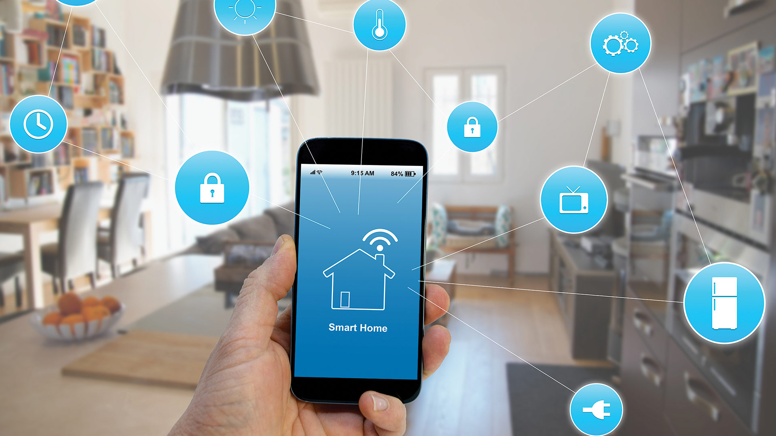
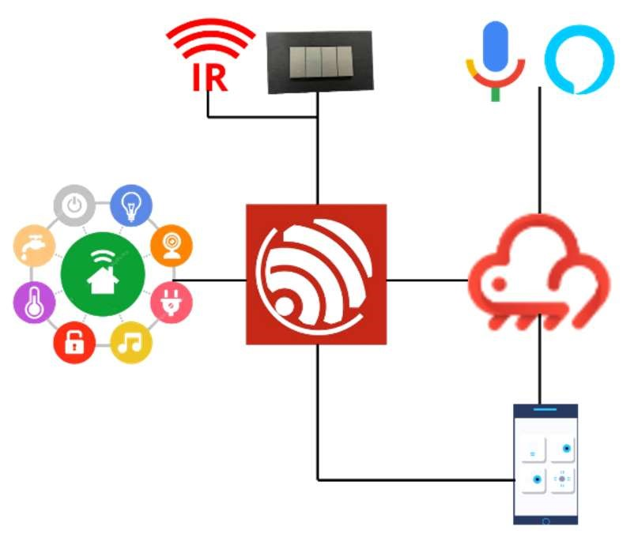
Abstract
This project is based on IoT Home Automation System. The aim of the project is to control all the appliances in a home like fan, light, motor etc., using Mobile (ESP RAINMAKER APP), Manual switches, IR Remote and Sensors.
ESP32 microcontroller is the core of the project which has inbuilt Wi-Fi and Bluetooth.
ESP rainmaker is an application that provides free cloud services and establish connections with voice Assistance and it provides automation based on scheduling.
Sensors like PIR, temperature, gas, etc .,for detection ,monitoring & controlling the appliances.This also sends mobile alerts to users via mobile app

Slide 4
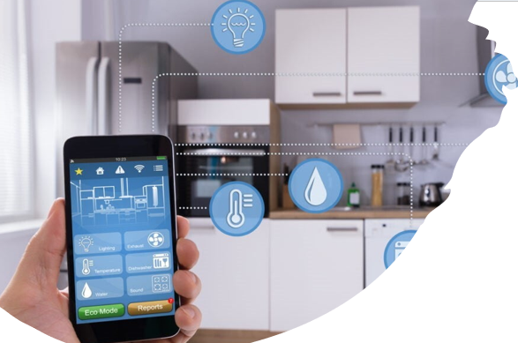
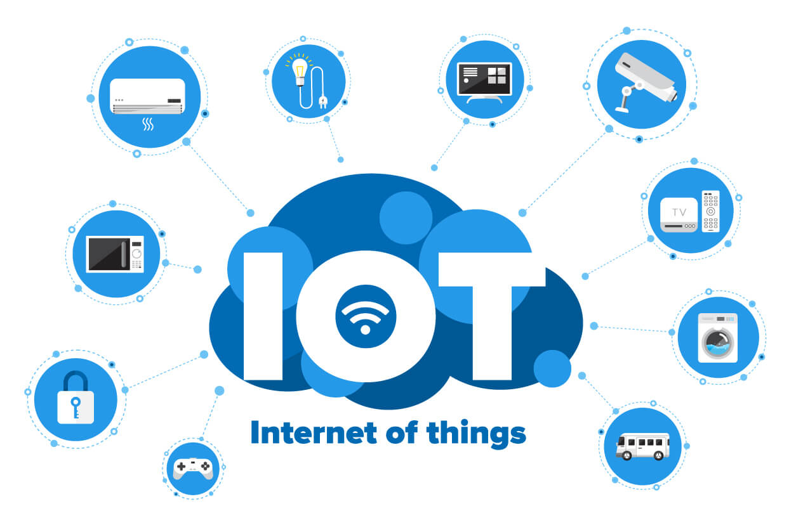
Introduction
A Smart Home refers to a convenient home setup where appliances and devices can be automatically controlled remotely from anywhere with an internet connection a mobile.
Iet us Imagine a home that anticipates our needs and adapts to our preferences with the simple touch of a button or a simple voice command. So this is the main agenda of this project To create an affordable and user-friendly smart home solution. Even a non-technical person can be able to use these services without any hesitation.

Slide 5
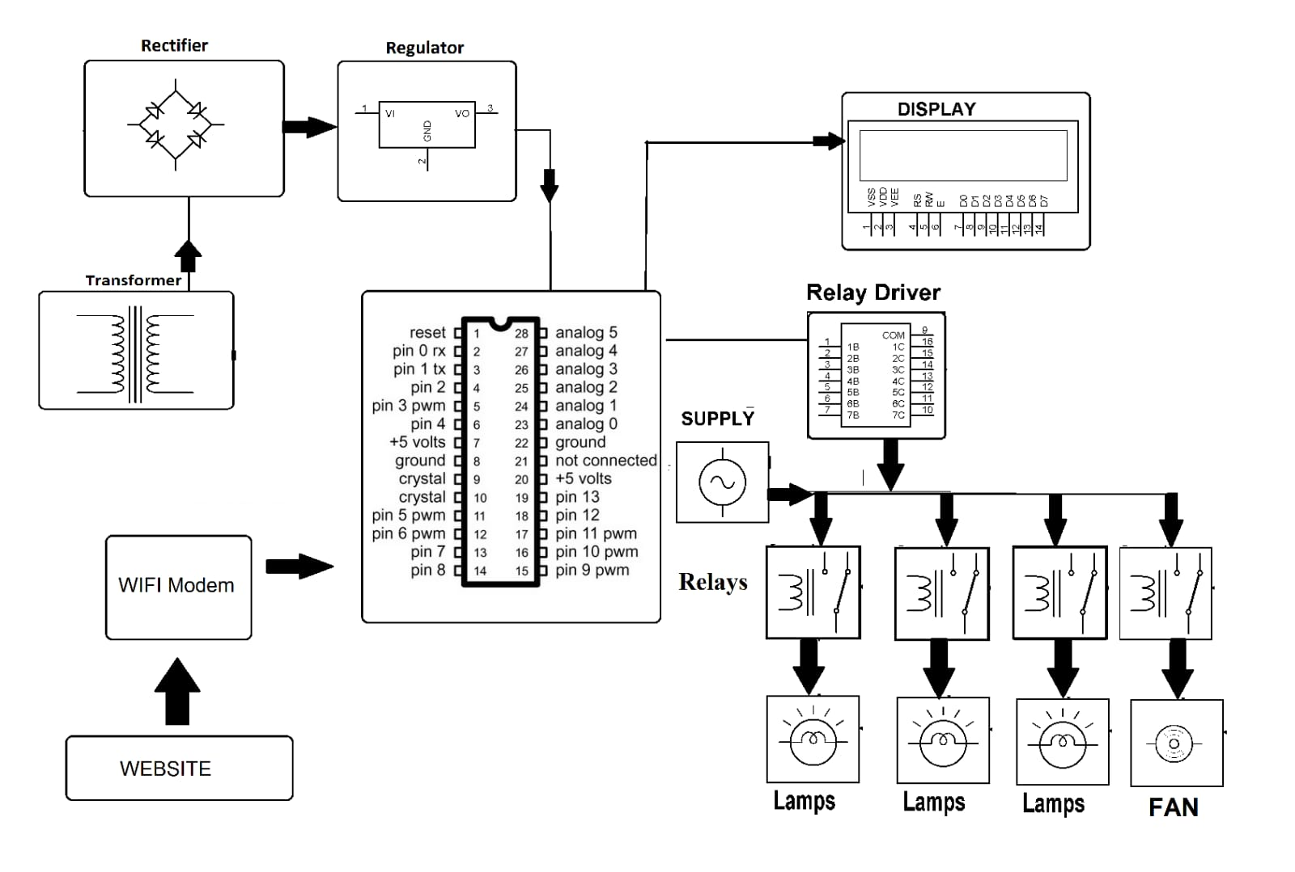
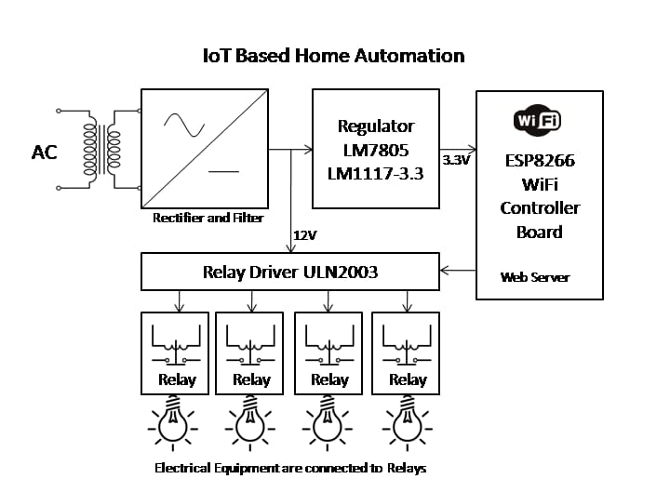
EXISTING MODELS
Draw back: No manual operations are possible, to overcome this, adding more controlled features like manual switches ,Sensors , IR-remote ,via mobile app, voice assistant like google , Alexa etc

Slide 6
Proposed System
The project involves two models one is for room and other for kitchen . Initially, it controls basic devices like fans, lights, detection of human, temperature, humidity, etc. that are connected to an ESP32. It allows control through IR remotes, manual switches, and a mobile app (ESP-Rainmaker) via Wi-Fi or the internet.
The system generates a QR code through serial communication for setup. To establish a connection, scan the QR code using the ESP-Rainmaker app and input Wi-Fi credentials from mobile device. Once connected, control is possible through the mobile app. Additionally, voice control is possible with assistants like Alexa and Google Home by linking them with Rainmaker.

Slide 7
IMPLEMENATION -Proposed Model(cont.) Room(node)
Connected to Wi-Fi
When the state of device changes by any of these controlled features, these changes are automatically, reflected back to the mobile app.

Slide 8
Node 1 Circuit

Slide 9
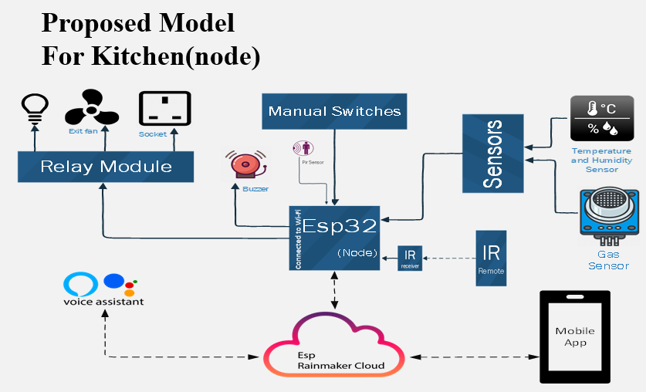
For kitchen point of view when there is gas leakage ,the gas sensor turns on and sends signal to ESP32.Automatically ESP32 activates the buzzer and device becomes idle . And also it sends an alert to mobile application. Based on this user can take necessary actions. Similarly, if the temperature exceeds a set value, a temperature sensor activates an exhaust fan to stabilize the temperature, preventing potential damage. A notification alert is sent to the user through the mobile app . Additionally, a DHT11 humidity sensor detects moisture in the kitchen, sending signals to the ESP32 for control of devices via manual switches or the mobile application.

Slide 10
Node 2 Circuit

Slide 11
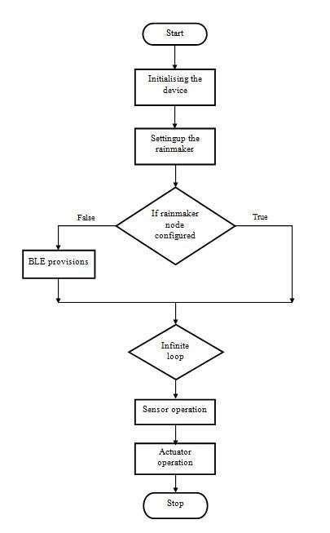
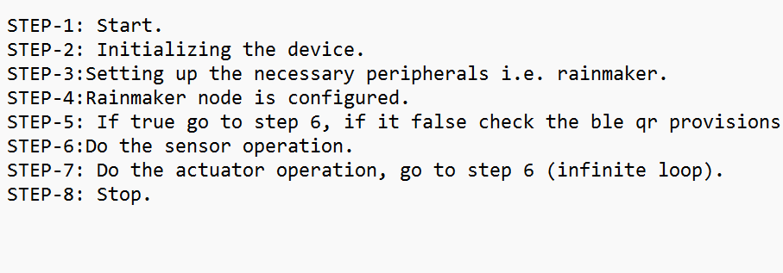
FLOW CHART:

Slide 12
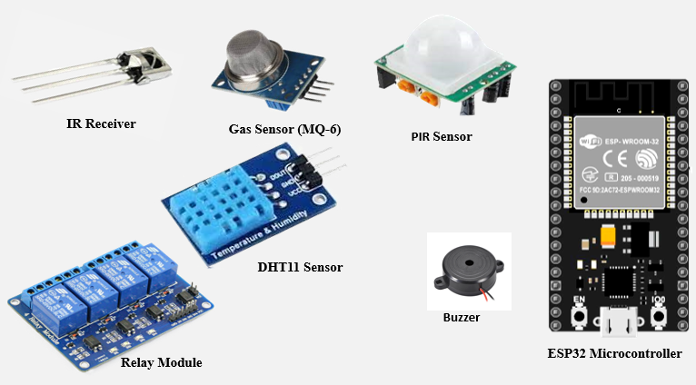
Components
ESP32 Microcontroller
Relay Module
Passive Infrared Sensor
IR receiver – IR Remote
DHT11 Sensor
Gas Sensor (MQ-6)
Buzzer

Slide 13
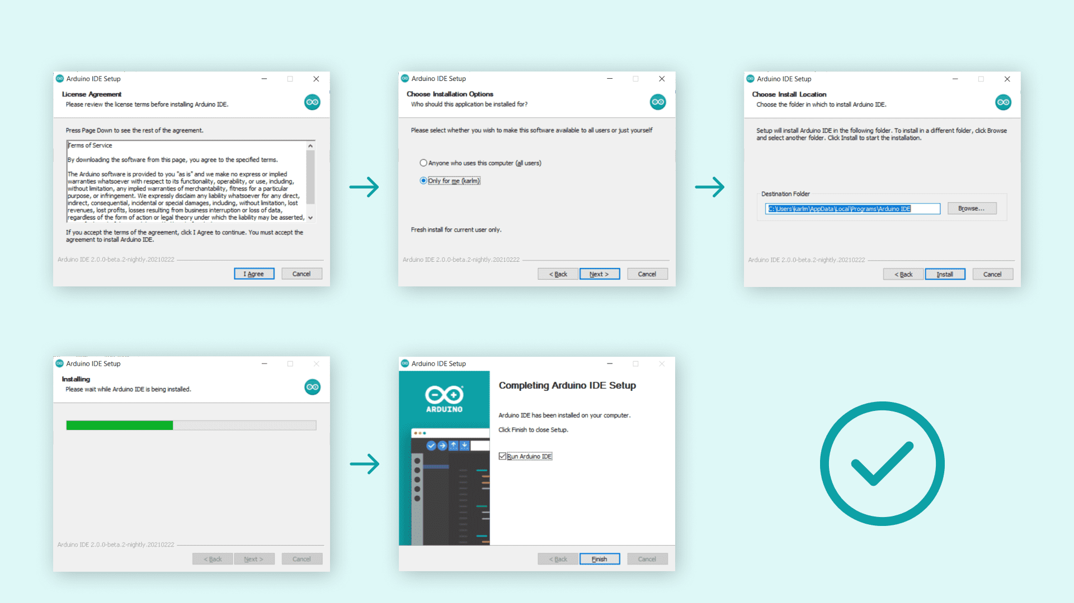
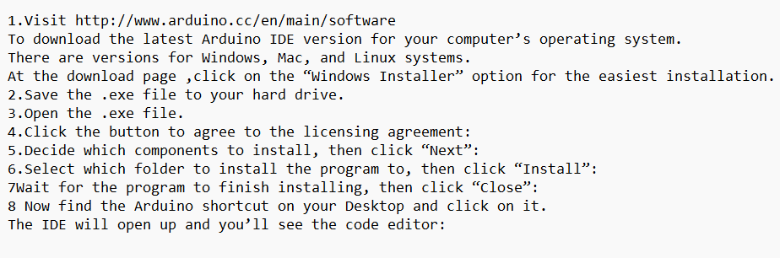
SOFTWARE REQUIREMENTS:
INSTALLATION OF ARDUINO IDE & INSTALLING THE ESP32 LIBRARIES IN ARDUINO IDE
ESP-IDF (ESPRESSIF IOT DEVELOPMENT FRAMEWORK) OR ARDUINO CORE FOR ESP32

Slide 14
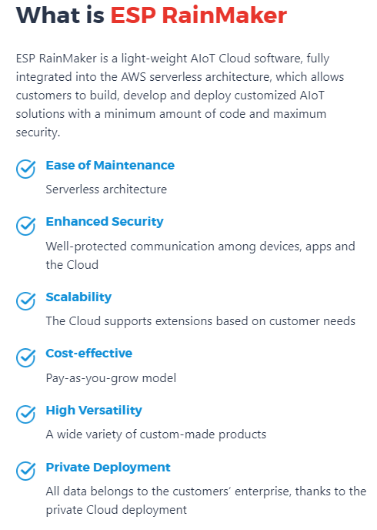
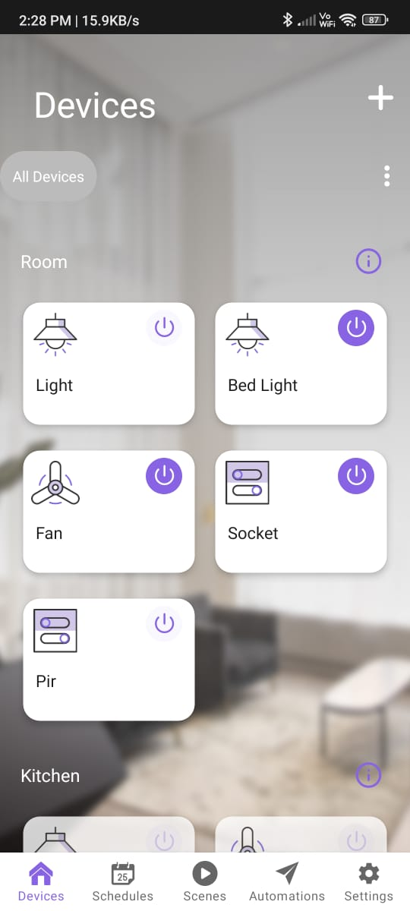
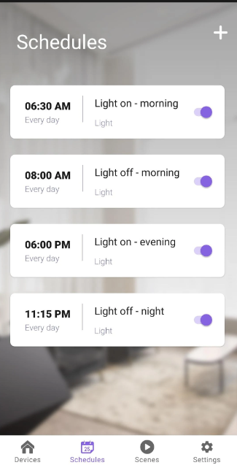
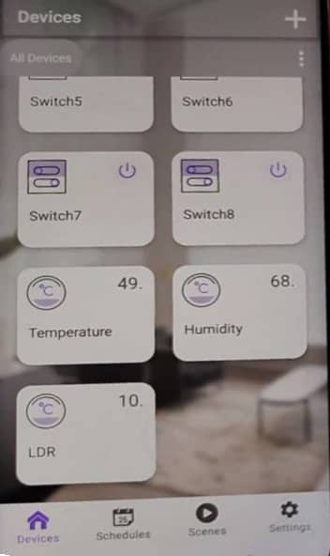

Slide 15
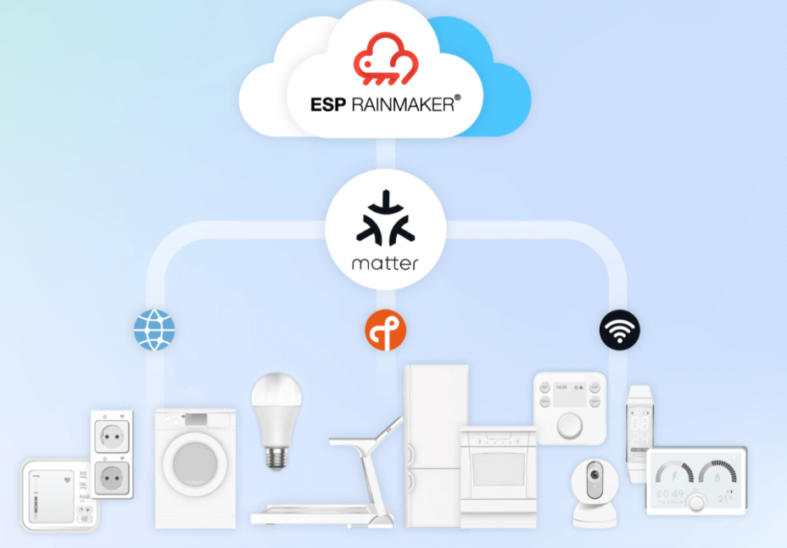
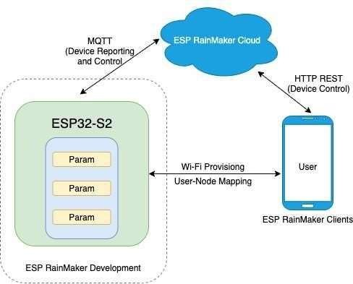
COMMUNICATION INTERFACES:
ESP32-S2 Device:
The microcontroller hardware which will be programmed to control and monitor various smart kitchen appliances, sensors, and functionalities.
Rainmaker Development:
Its an environment provided with Tools and framework for programming the ESP32-S2 device.
Wi-Fi Setup & User Access:
Configuring wireless connectivity and associating users with the device.
Rainmaker Cloud:
Acts as the central hub for the smart kitchen system. Cloud service for device data reporting, control through the MQTT protocol, and providing an API..
User Apps & Interfaces:
Mobile apps or web apps that users interact with to control and monitor the smart kitchen system through the cloud.

Slide 16
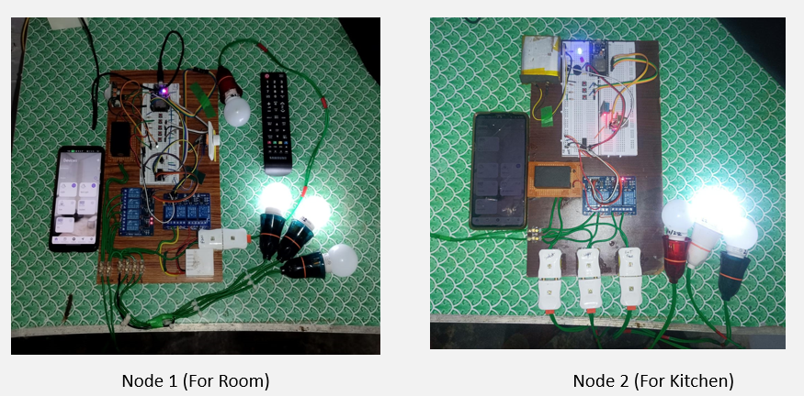
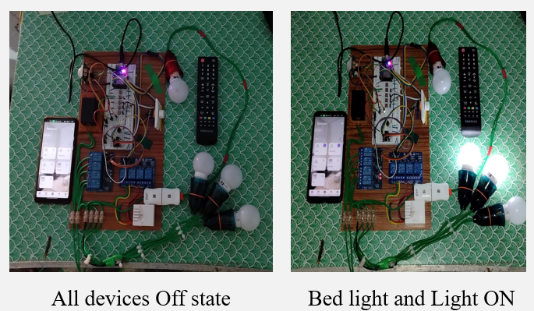
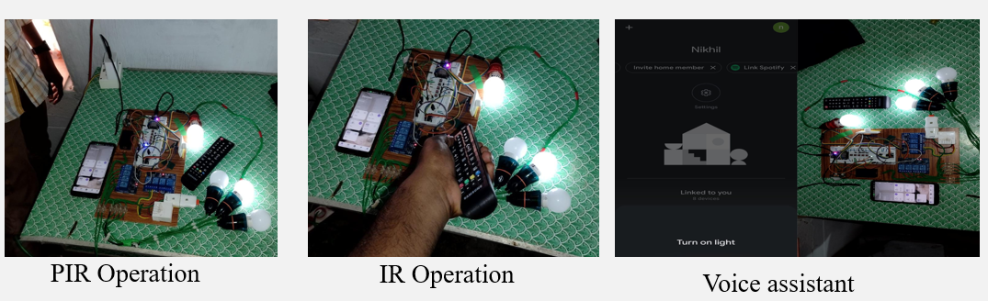
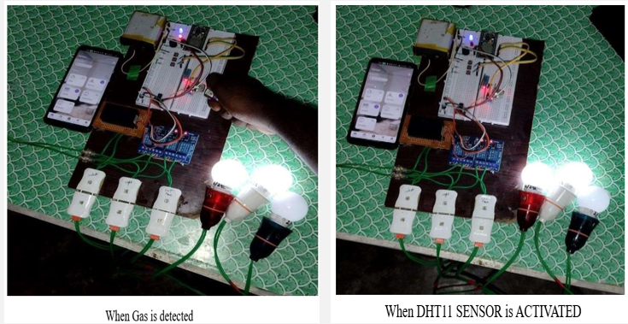
Results

Slide 17
CONCLUSION:
Over all, this system allows you to remotely control and monitor various aspects of our home via our smartphone, providing added convenience, security, energy management, and cost reduction benefits.
I'm taking this project to the next level by integrating an innovative sensors (e.g., air quality, ultrasonic), and devices like (e.g., smart mirror, electricity energy meter, fridge ,AC, washing machine, microwave etc)Also by including machine learning algorithms and NLP model for various tasks like recipe assistance, inventory tracking, and energy optimization. By using Advanced communication technologies like LoRa and ZigBee which allow us to monitor and automates everything from garden irrigation system to smart parking.
The project envisions a future where home automation simplifies daily life, reducing manual tasks. For the elderly or those with disabilities, it could be a life-changing companion – managing healthcare needs, providing personalized assistance, and ensuring every day is a little bit easier.

Slide 18
REFERENCES
[1]. S. Anand, A. Awasthi, A. Verma, Z. A. Khan and A. A. Khan, "IoT Enabled Home Automation System Comprehending the User Experience Based on Their Pattern Usage," 2020 Fourth International Conference on Computing Methodologies and Communication (ICCMC), Erode, India, 2020, pp. 932-934, doi: 10.1109/ICCMC48092.2020.ICCMC-000172.
[2]. Meena Kasbekar, Nida Khan, Atharva Kadam, and Prof. Milind Gajare. "Home Automation Using IoT." International Journal of Advanced Research in Science, Communication and Technology 5.1 (2021): 487-492. DOI: 10.48175/IJARSCT-1176. ISSN (Online) 2581-9429.
[3]. P. Rai and M.Rehman,"ESP32 Based Smart Surveillance System," 2019 2nd International Conference on Computing, Mathematics and Engineering Technologies(iCoMET),Sukkur,Pakistan,2019,pp. 1-3, doi:10.1109/ICOMET.2019.8673463.
[4]. K. Mandula, R. Parupalli, C. A. S. Murty, E. Magesh and R. Lunagariya, "Mobile based home automation using Internet of Things(IoT)," 2015 International Conference on Control, Instrumentation, Communication and Computational Technologies (ICCICCT), Kumaracoil, India, 2015, pp. 340-343, doi: 10.1109/ICCICCT.2015.7475301.

Slide 19
THANK YOU

